Slide 1
CIS 55 – iOS Programming
Manish Goel

Slide 2
Lecture Objectives
Introductions
Syllabus, Labs and Tests
Roll Call, Adds and Drops
iOS Development
iOS Overview
Development Needs
“Hello World !!”
Hands-on Lab

Slide 3
Introductions
About the Instructor
About the Students
Prior programming experience?
Familiarity with Object Oriented Programming?
Familiarity with Mac OSX and/or iOS development?
Syllabus, Labs and Tests
Catalyst Course page – Syllabus PDF
Collaboration vs Plagiarism

Slide 4
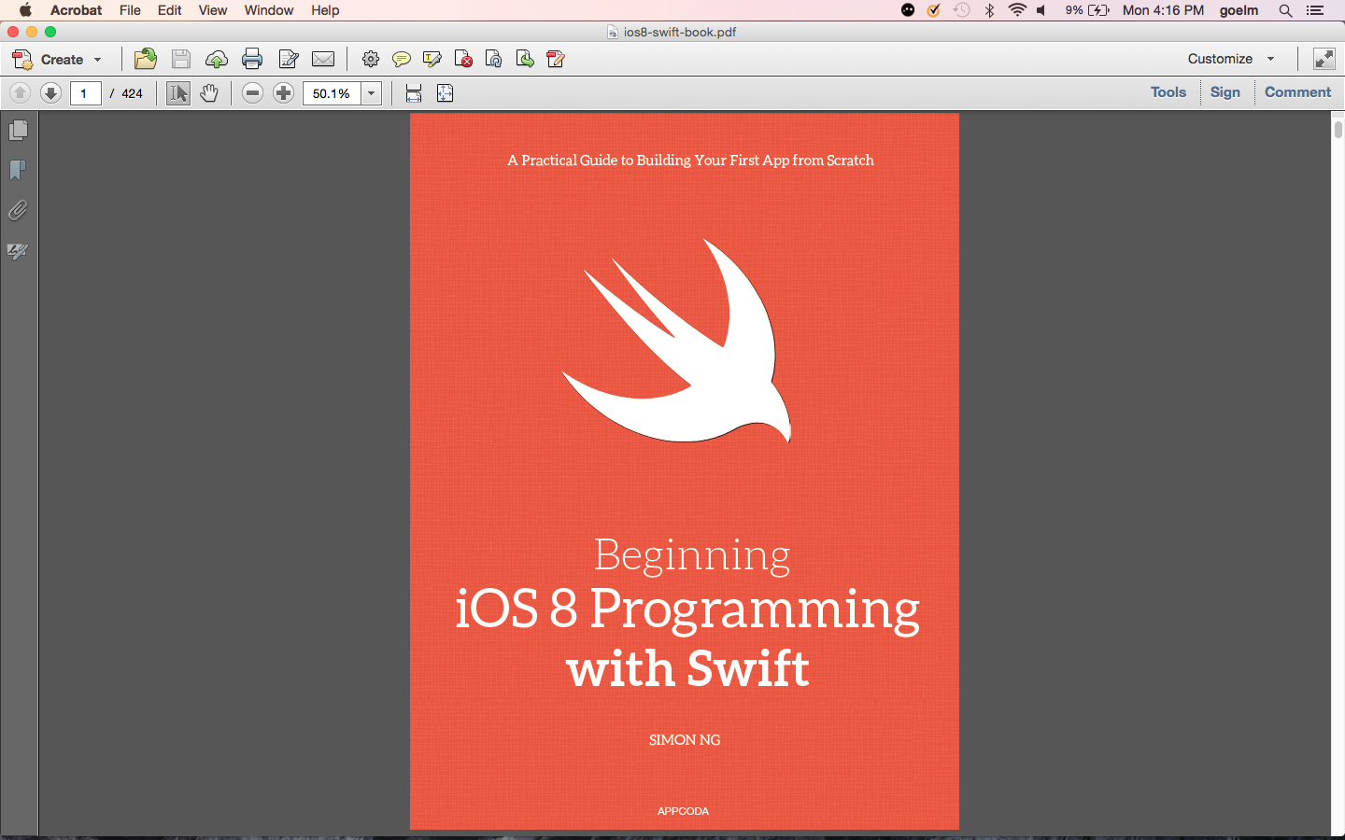

Slide 5
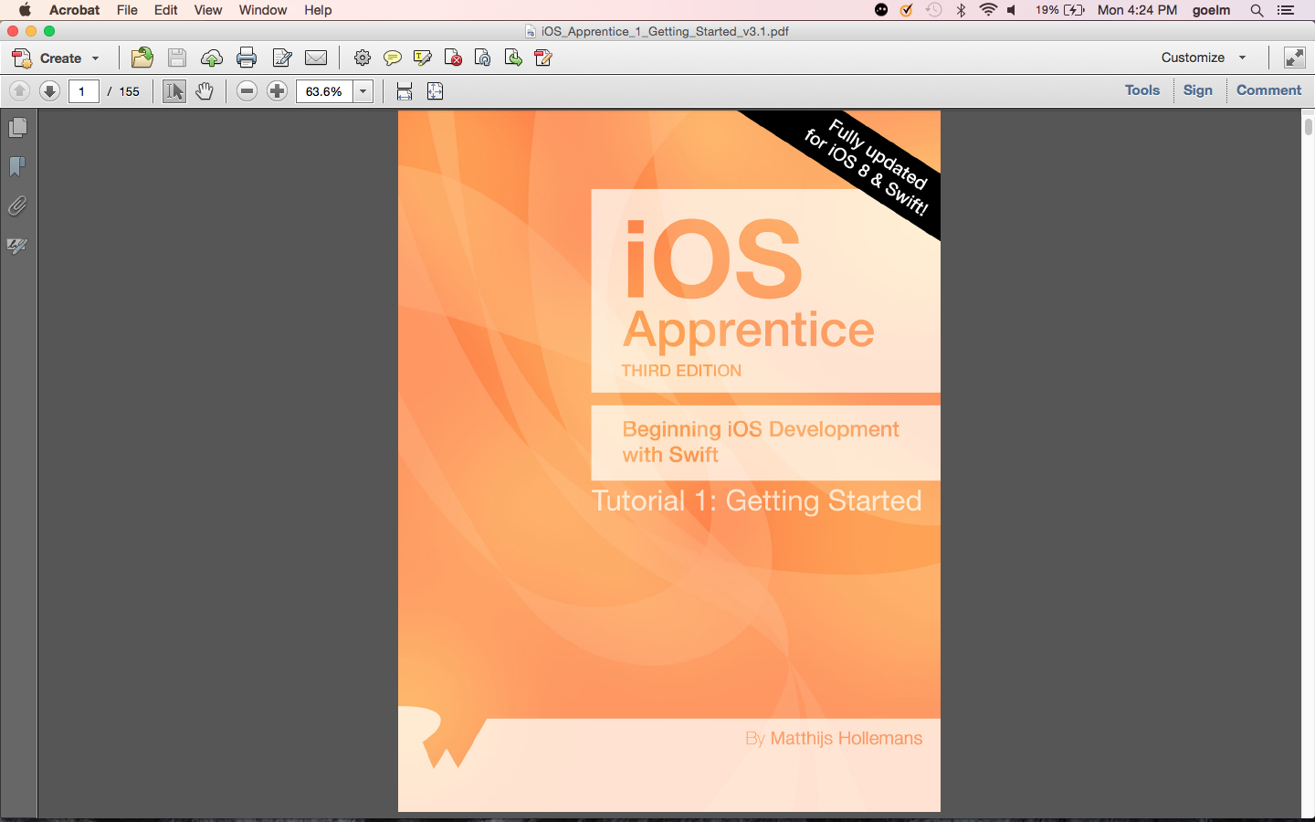

Slide 6
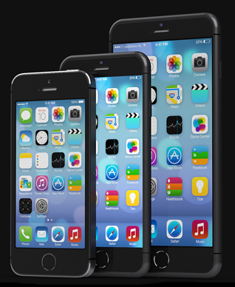
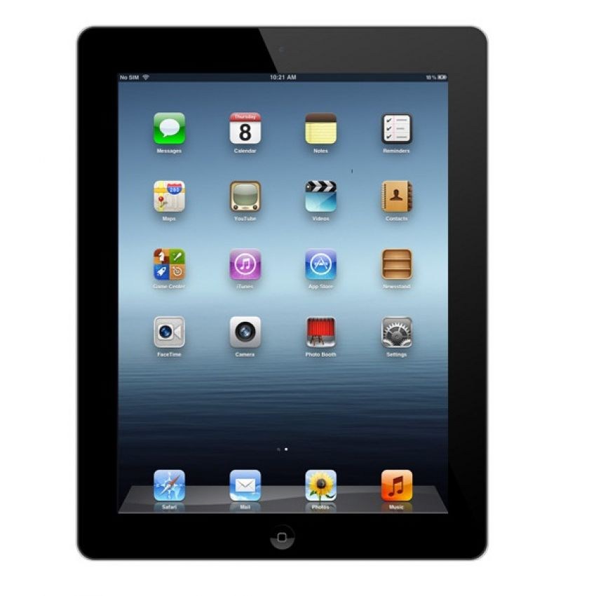
iOS Development

Slide 7
iOS Development Needs
Mac with OSX 10.10 (Yosemite) or higher
Macs in ATC 203 Computer Lab
Username: cisstudents Password: Winter15!
DO NOT SHARE THIS WITH PEOPLE NOT IN CLASS
Individual Apple Developer accounts
Apple developer accounts are free
Use the same email as for the course
This allows you to test your iOS code in Simulator only

Slide 9
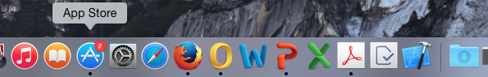
iOS Development Needs (cont.)
Download & Install Xcode 6.1.1
Xcode is Mac’s IDE (Integrated Development Environment)
Search for and download from the Mac App Store
Xcode

Slide 10
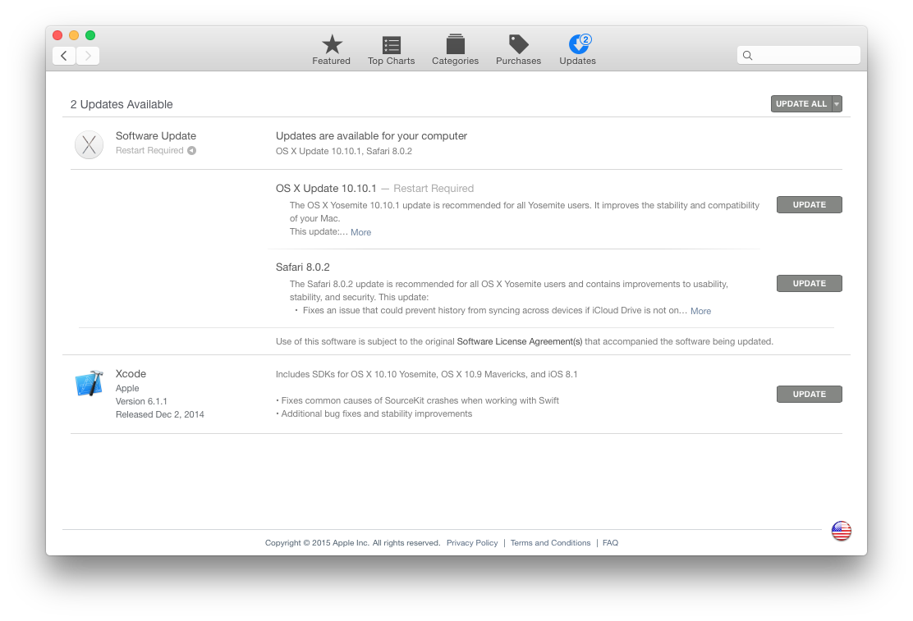

Slide 11
iOS Development – Optionals
iPhone, iPad or iPod Touch for testing
Not needed – Xcode includes simulators
Enrollment in iOS Developer Program
Enroll with the same email as Apple Developer registration
Allows device based testing – otherwise simulator only option
$99 annual fee
De Anza has joined the iPhone Developer University Program
$99 annual fee waived for enrolled students
Do not register – accept iOS developer invite sent by me
Invites will be sent out in Week 3 – after all add/drops have been processed
Allows publishing your code for your class mates to use also

Slide 12
Before We Begin
iOS Programming is Visual:
Apps are designed top-down, i.e. UI first, code later
UI is designed by putting UI elements on a Storyboard
UI elements are predefined controls provided by Xcode
Once UI looks good, define what those controls will do
Outlets and Actions
Outlets allow data to be interchanged between the user and app – I/O
Actions do some work in relation to some event

Slide 13
Hello World !!
Hello World – the first program for any new platform
Demonstrates concepts to provide a feel for the paradigm
For iOS – we will do it in two ways:
Objective-C based Hello World – for iOS 7 or earlier
Swift based Hello World – for iOS8 or later
This class will primarily focus on Swift programming paradigm only

Slide 14
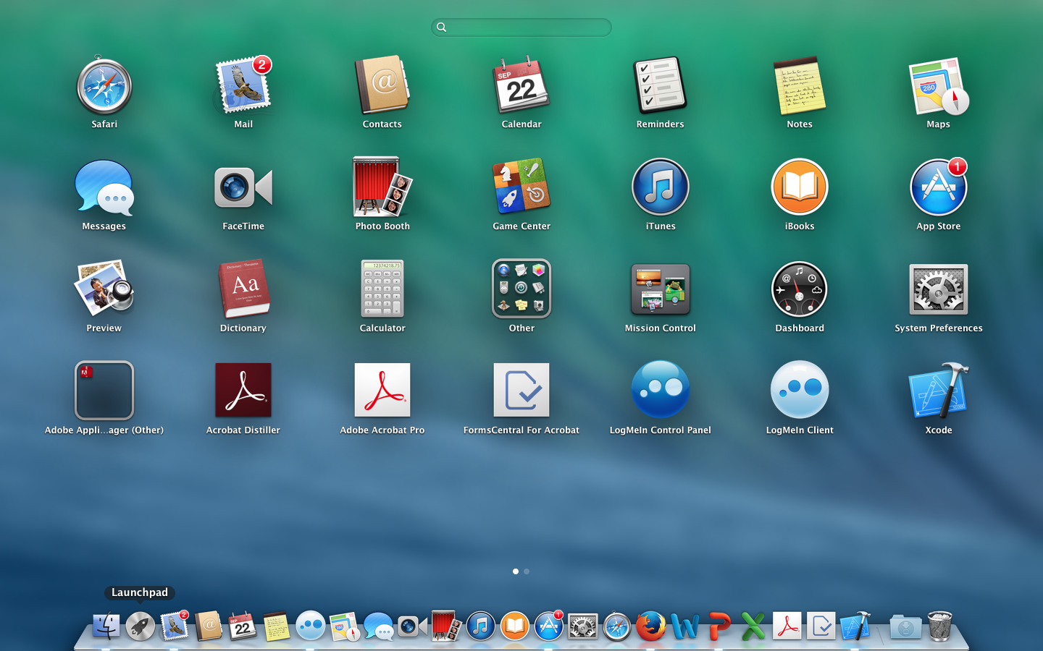
Hello World !!

Slide 15
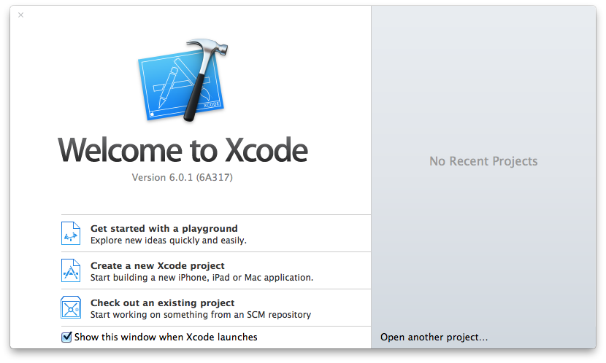
Hello World !!

Slide 16
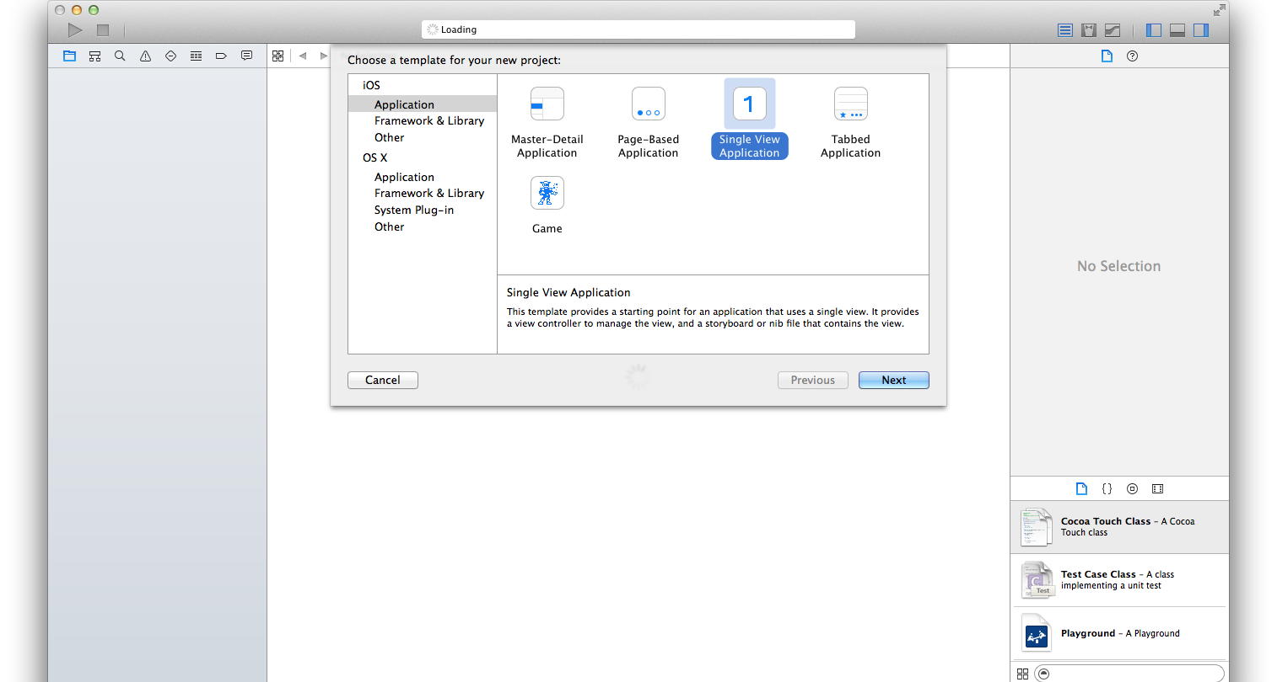
Hello World !!

Slide 17
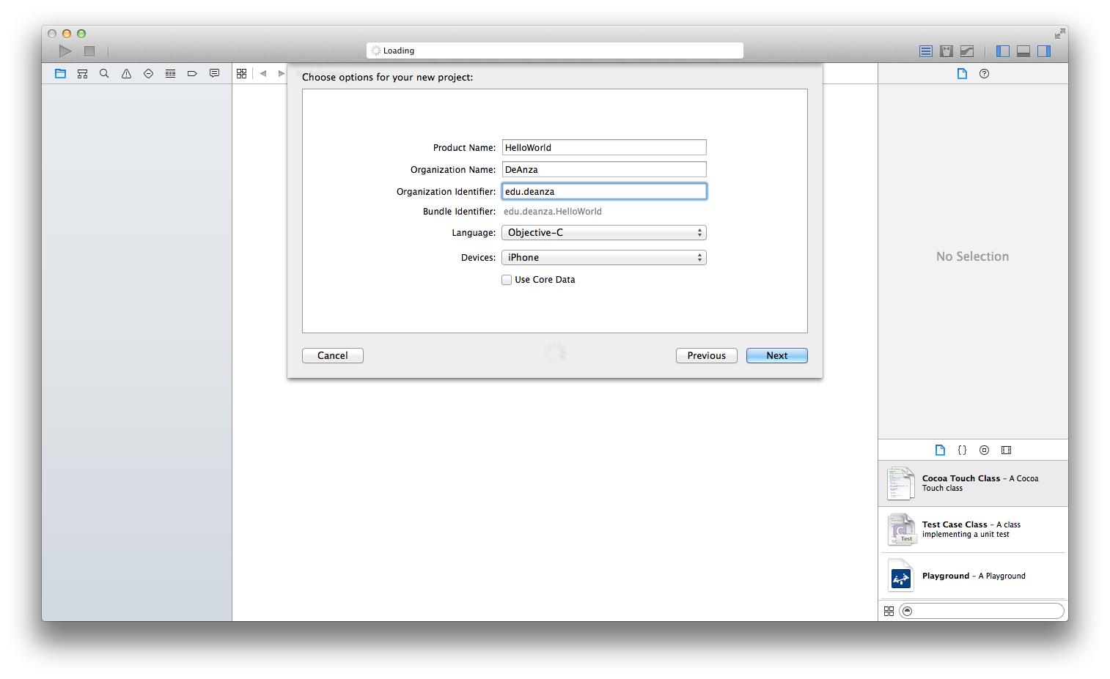
This identifies the organization owner of the app and is stamped inside the app
Hello World – using Objective-C

Slide 18
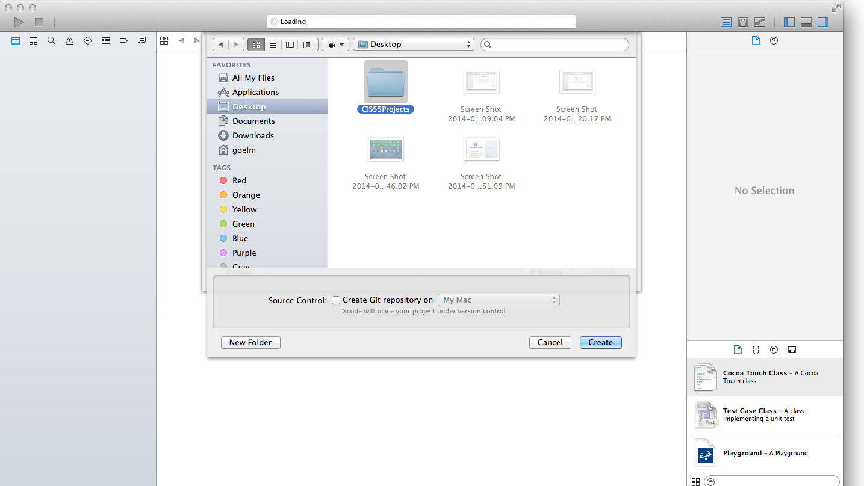

Slide 19
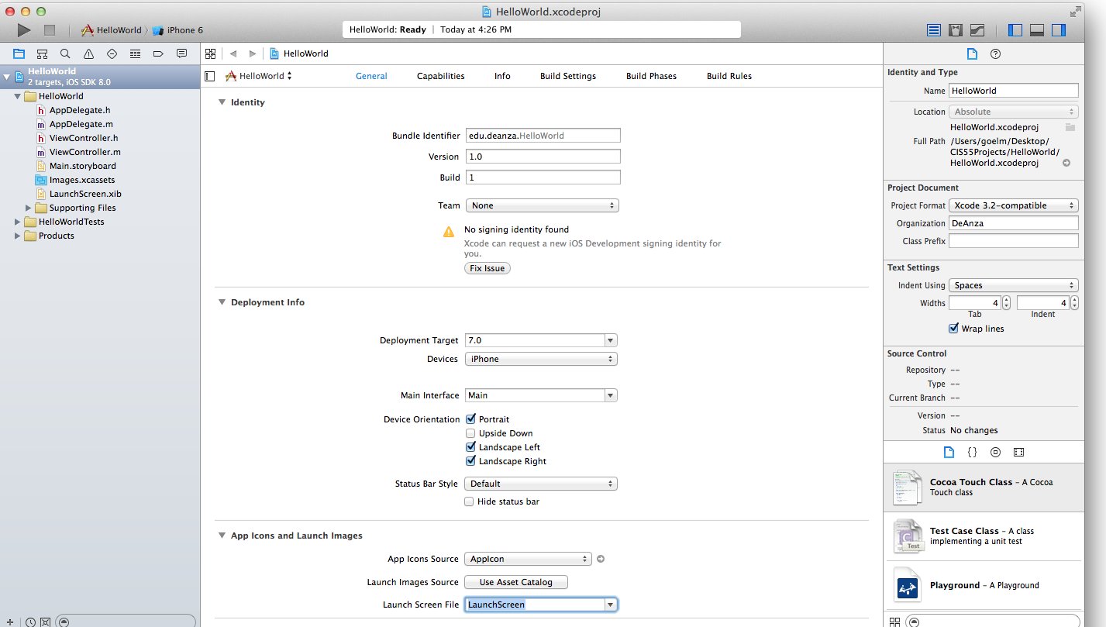
Project
Novigator
Project
Properties

Slide 20
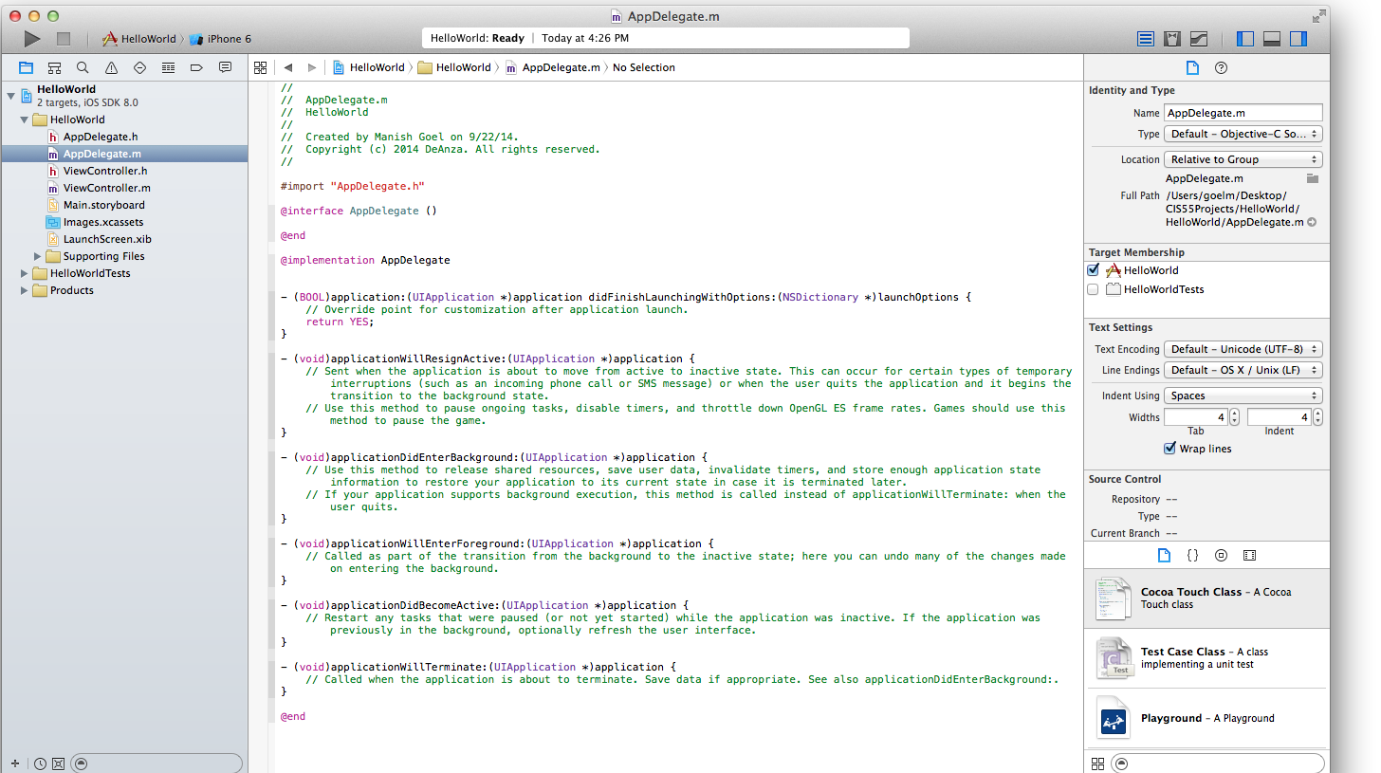
Editing
Section
Toolbar
Project
Novigator
Utility
Section

Slide 21
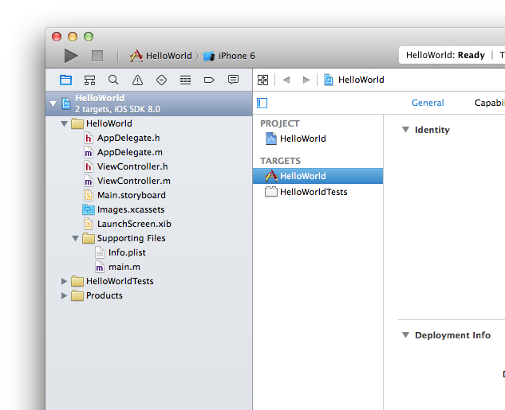
Simulator
Selected
Run to
compile for
simulator
Your app’s main program interface and implmentation
Your app’s View Controller
Your app’s splash screen interface builder
Your app
which will
be built
Application
Main – tracks
memory usage
and calls
AppDelegate
The main storyboard for your app

Slide 22
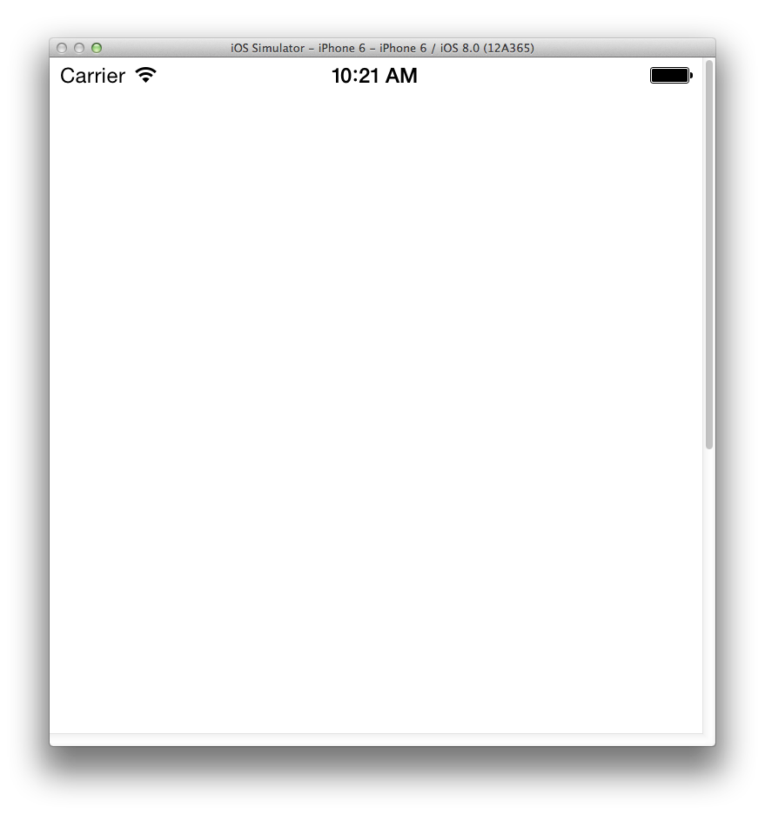
When you run for the first time, the simulator compiles and publishes the app to itself, shows the splash screen briefly and then ends at an empty screen. This is because we haven’t added any functionality to the app as yet.
Be patient – the simulator can take some time to load up.

Slide 23
A closer look at the project
main.m –
This is the main which is called by the iOS to run your app.
Initializes @autoreleasepool to keep track of resource / memory usage and frees them as necessary
Calls the main for the UI since that is how visual apps are structured
Info.plist –
A manifest of all the essential properties the app will expose to iOS once published
LaunchScreen.xib –
The interface builder for the splash screen of your app – it is visually designed using drag and drop
Images.xcassets –
An inventory of image resources used in the app starting with the AppIcon that shows up on the device to launch the app

Slide 24
A closer look at the project - 2
AppDelegate.h –
The default or main delegate interface (header) of your app – see the keyword ‘@interface’
Imports (or includes) UIKit.h which provides for using iOS UI capabilities
AppDelegate.m –
The default or main delegate implementation (code) of your app – see the keyword ‘@implementation’
Contains six main methods – their inline documentation clearly explains their purpose within the app
ViewController.h –
The interface of your app’s DEFAULT view controller, i.e. the connection between the UI and app main
Default viewcontroller.h doesn’t need to be explicitly included in the appdelegate.m, others will need to be
ViewController.cpp –
The implementation of your app’s DEFAULT view controller which contains two main methods
Main.storyboard –
This is the drawing board where you will start putting your visual resources to make the app useful

Slide 25
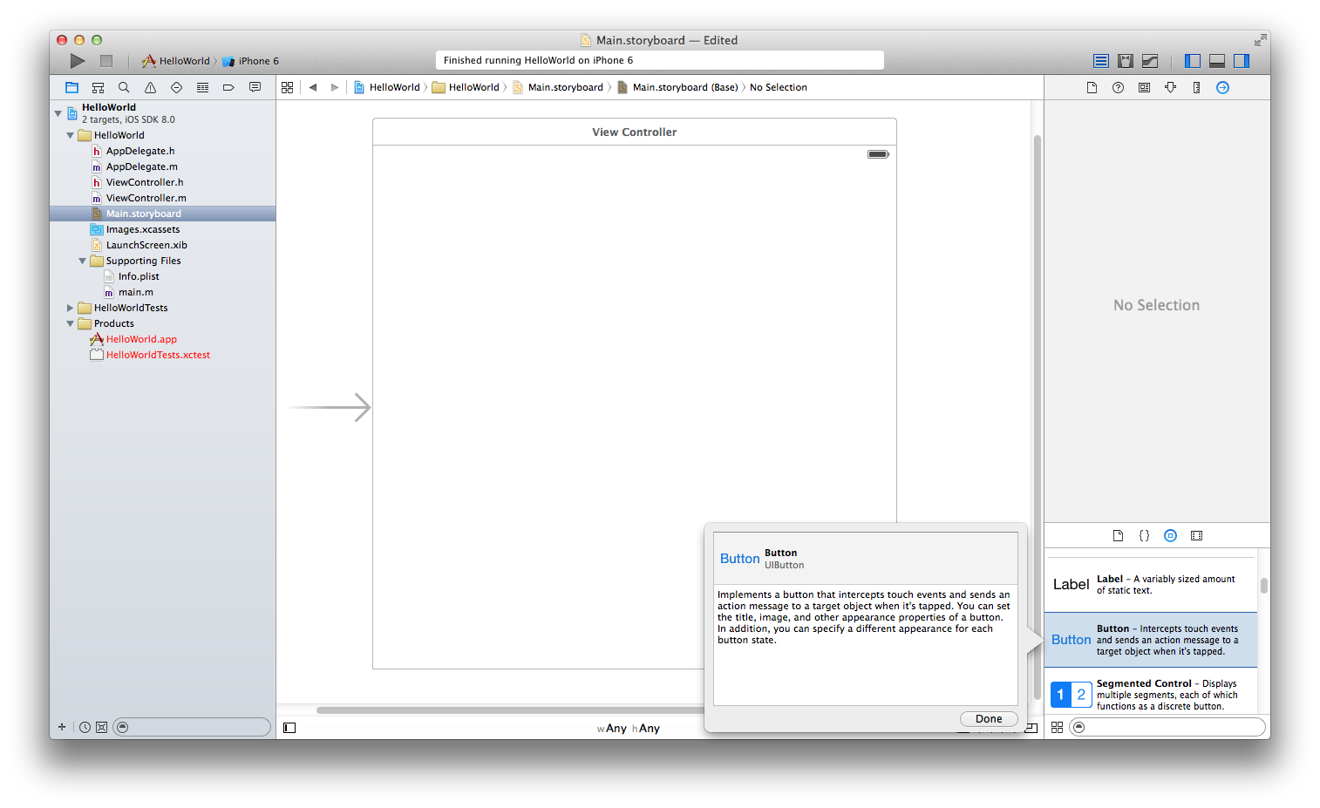

Slide 26
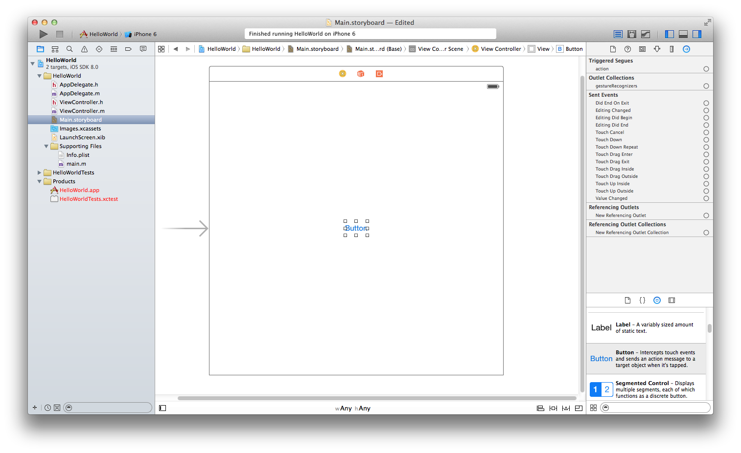
Drag and drop a button to the center of the storyboard

Slide 27
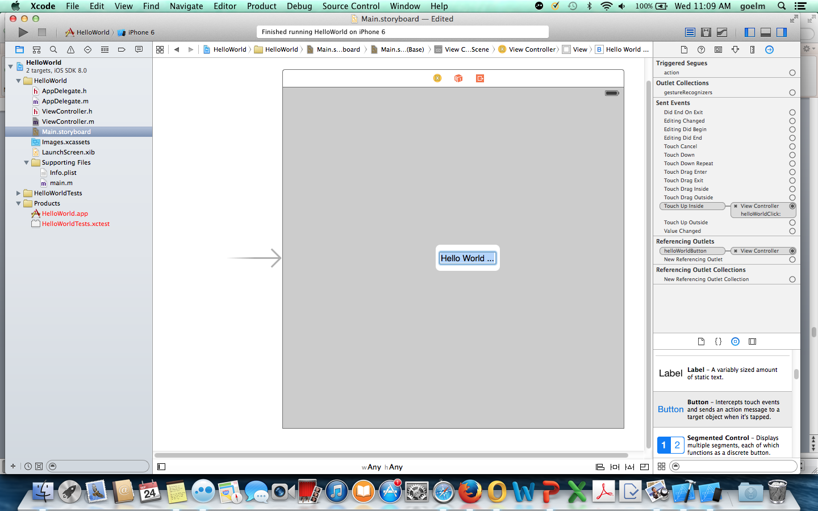
Let’s give the button some label – also highlight the background using the identity inspector on the RHS
If you run the app now, nothing will happen as we haven’t connected the changed storyboard to the ViewController

Slide 28
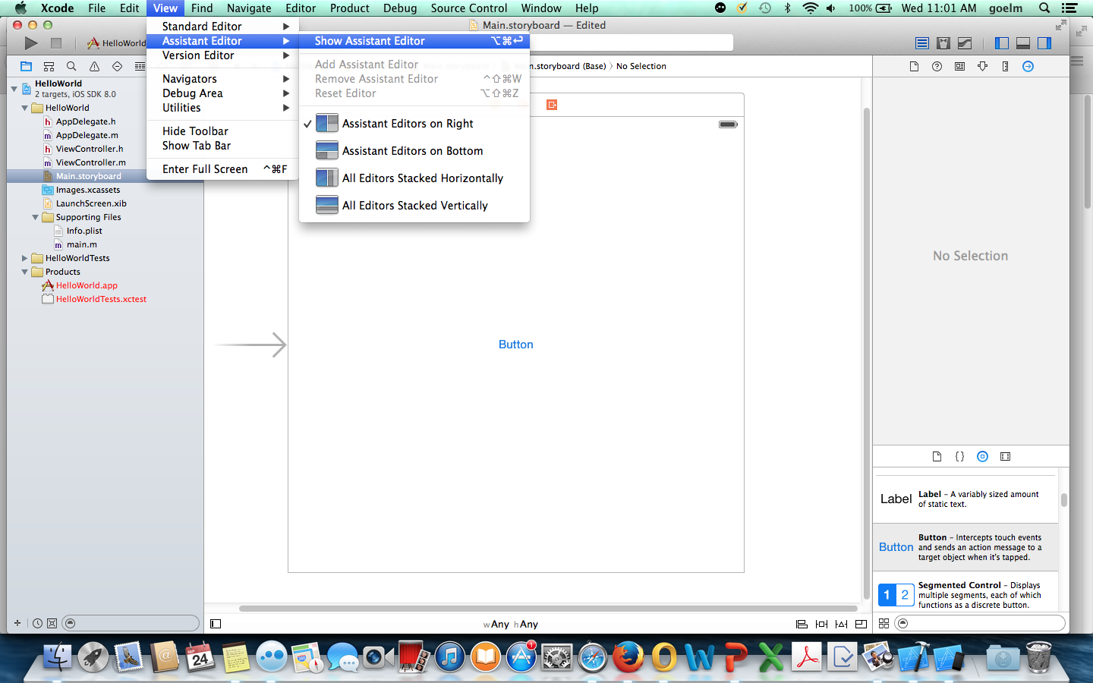
To connect the button to your ViewController, bring up the Assistant Editor making sure the Main.storyboard file was selected in the project navigator. This will open up the ViewController.m in right hand editor.

Slide 29
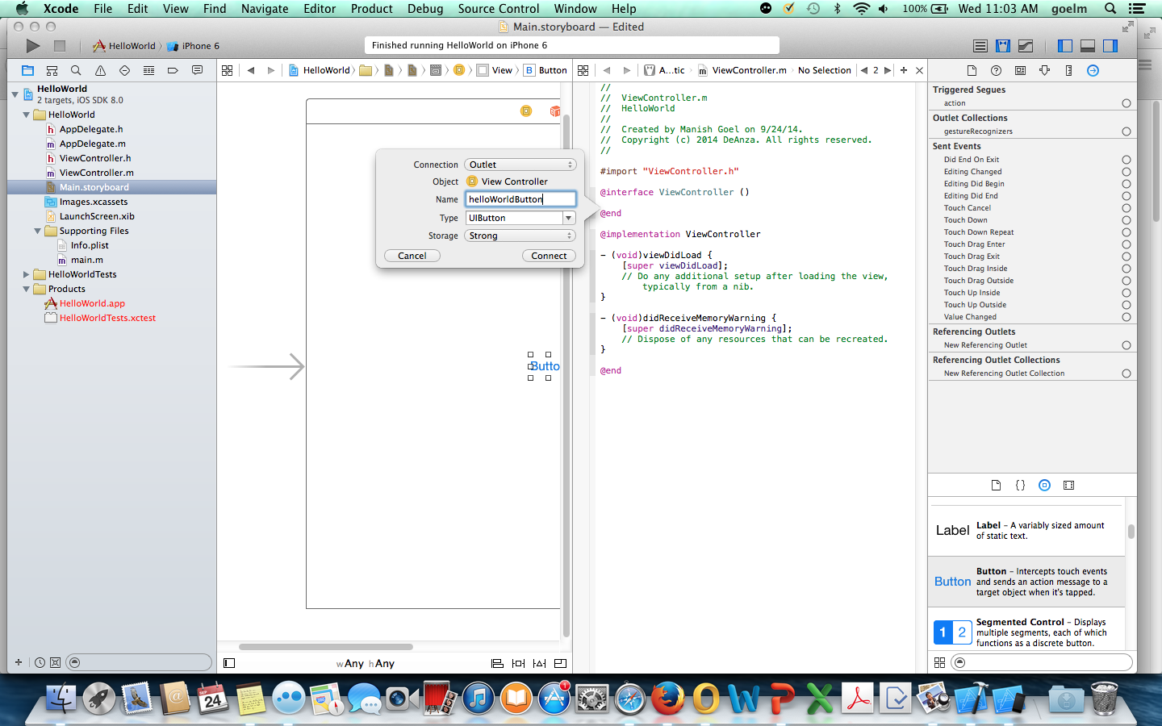
First we need to define an Outlet, i.e. an interface for the button –
To do this, move your mouse on the button until the hand appear, press and keep pressed the mouse-pad, then click and keep clicked the Control button and then drag the button with the other hand to the right editor between the @interface and @end on top – you should see a black text box indicating an outlet. Now let go.
Once the popup appears, provide a name without spaces – this will create the code for the outlet you need.

Slide 30
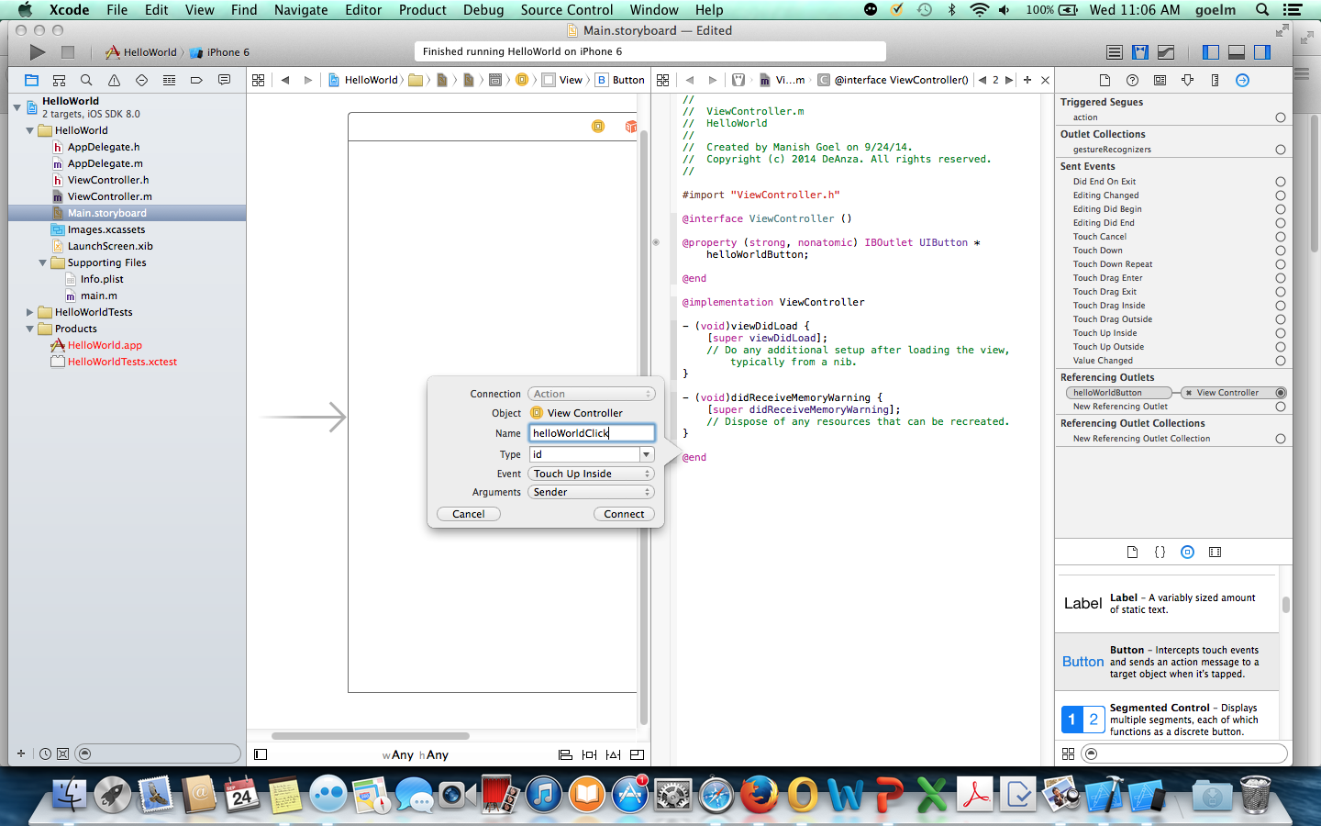
Repeat the press/drag process a second time to just before the last @end of the file – this will give you the indication of creating an action for the button.
Now the button has been connected to the View Controller.

Slide 31
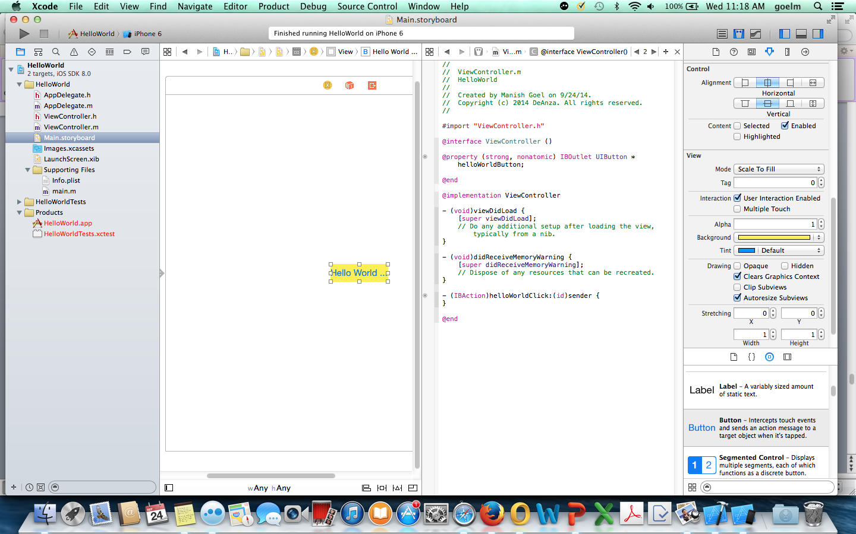
Now if you run the app again, the button will be clickable but nothing will happen as we haven’t added any response to the button action.

Slide 32
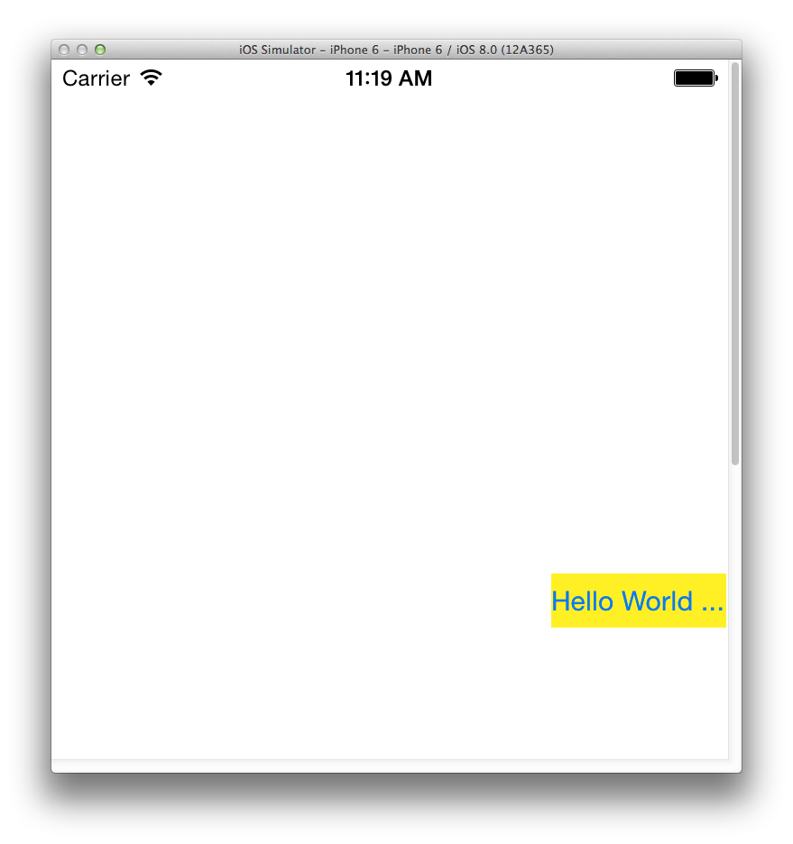
Don’t worry that the button doesn’t show up in the center – it is because we chose the form factor to be any height, any width and the simulator tries to optimize

Slide 33
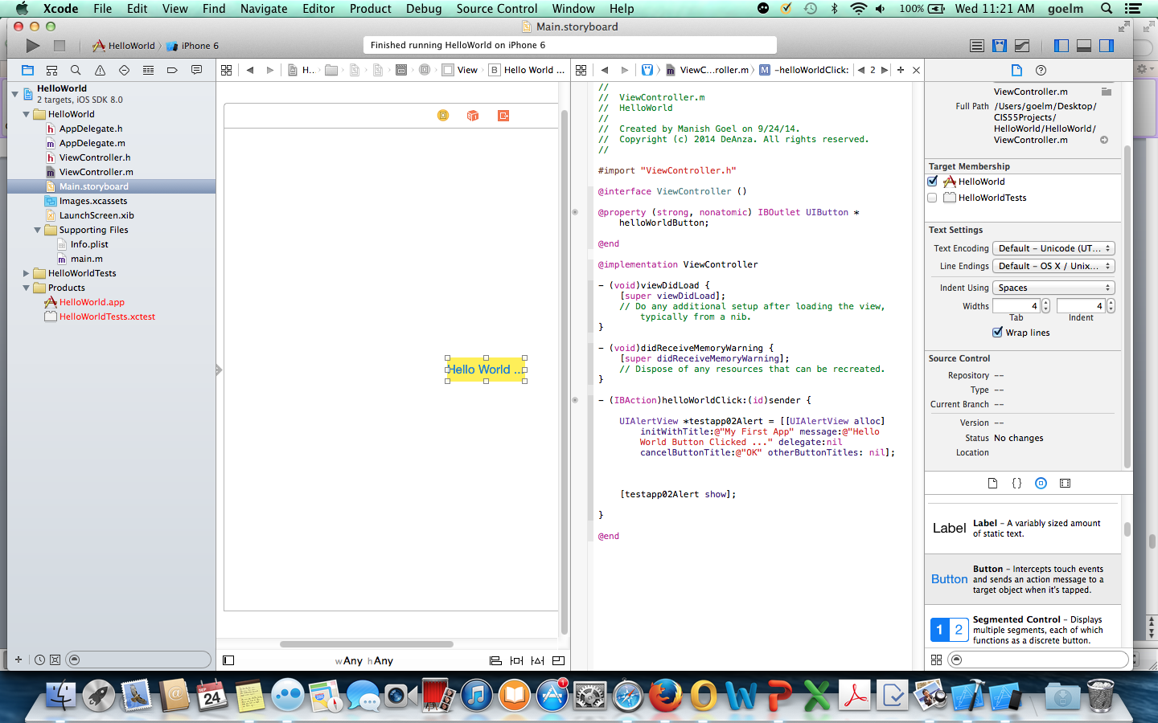
Add these two lines of code to the @IBAction method to define properties and response for the button.
Now when the app is run, it will provide a response will be shown.

Slide 34
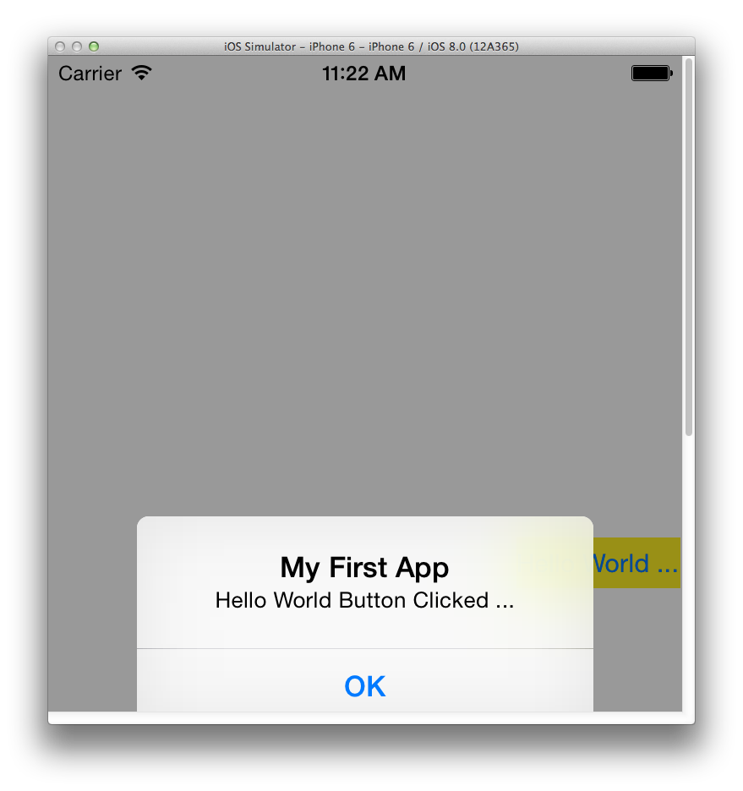

Slide 35
Hello World – using Swift

Slide 36
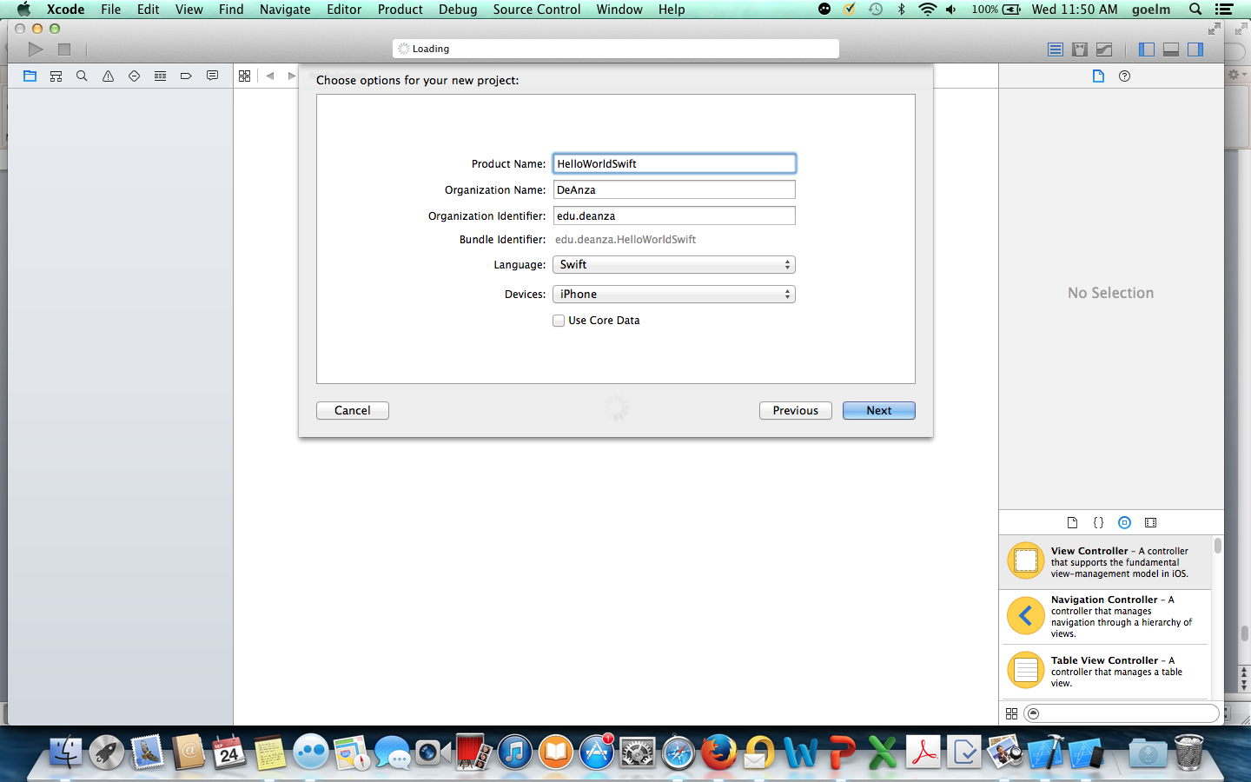

Slide 37
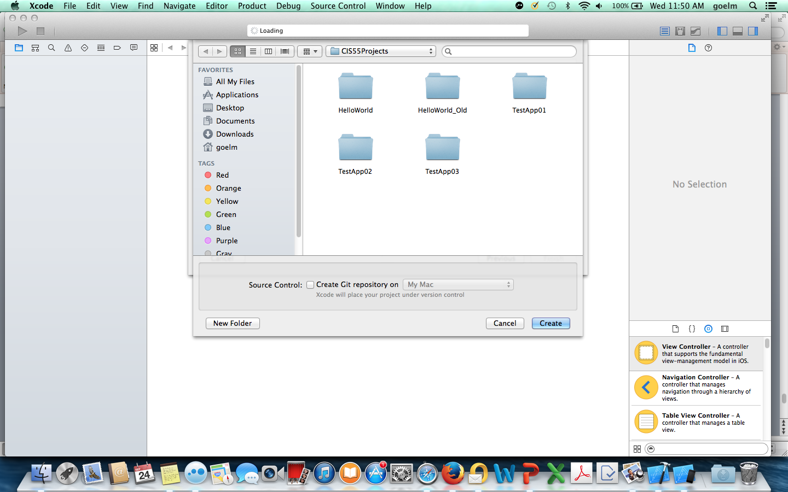

Slide 38
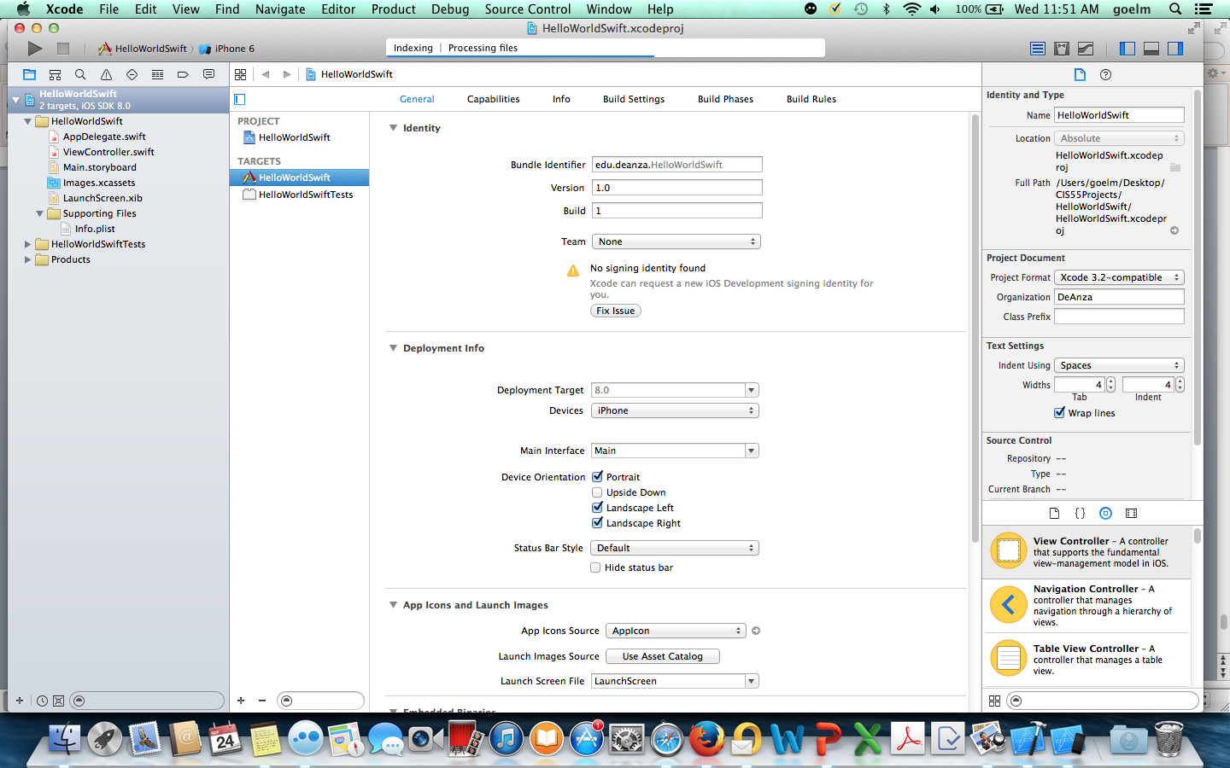
Interface and Implementation are now combined into one. No more application main – control is passed directly to AppDelegate.swift

Slide 39
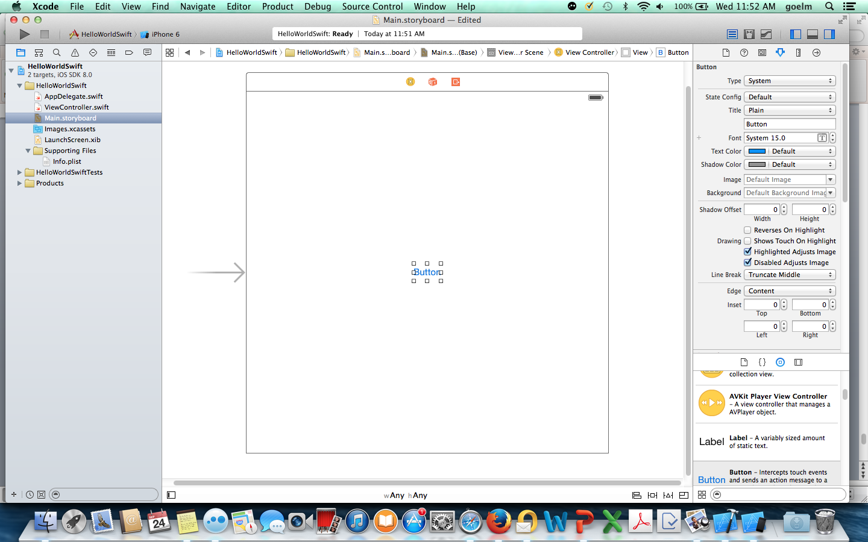

Slide 40
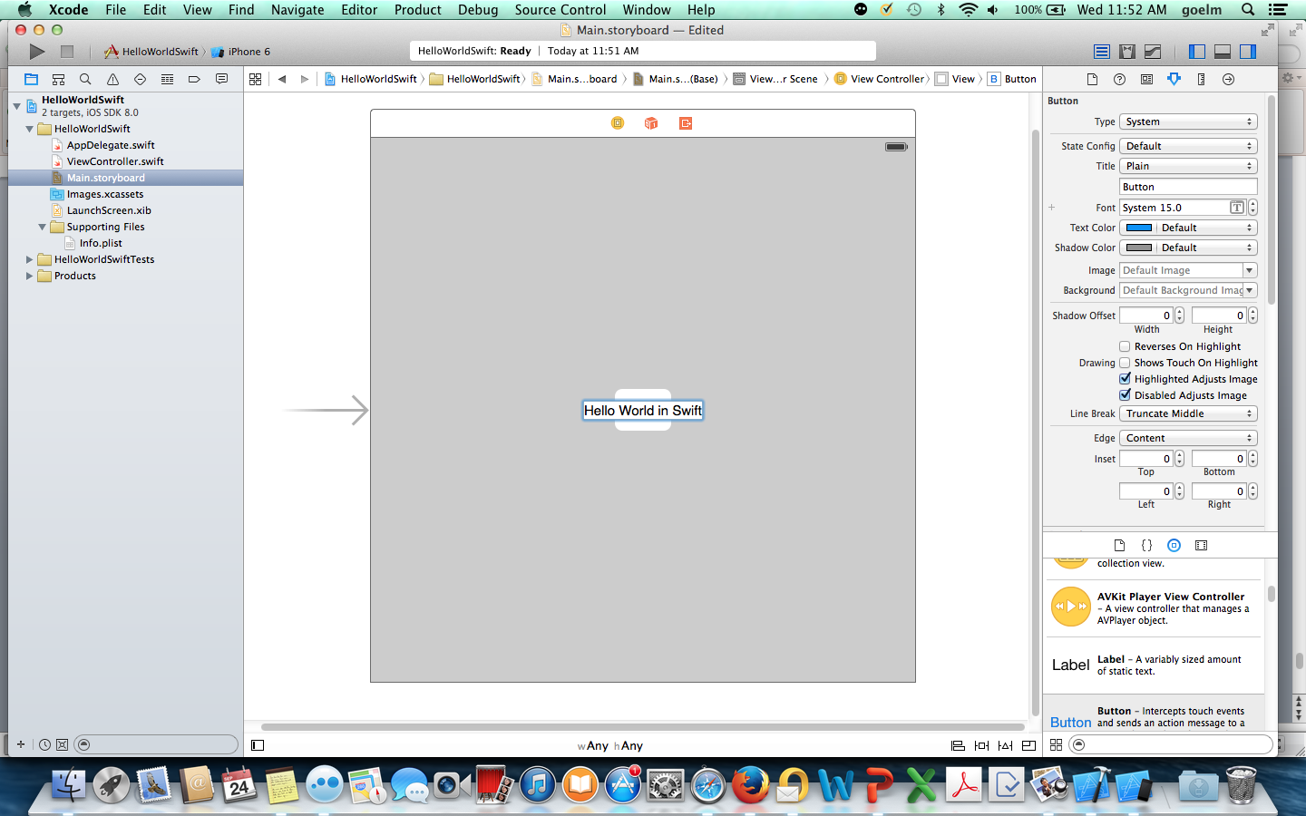

Slide 41
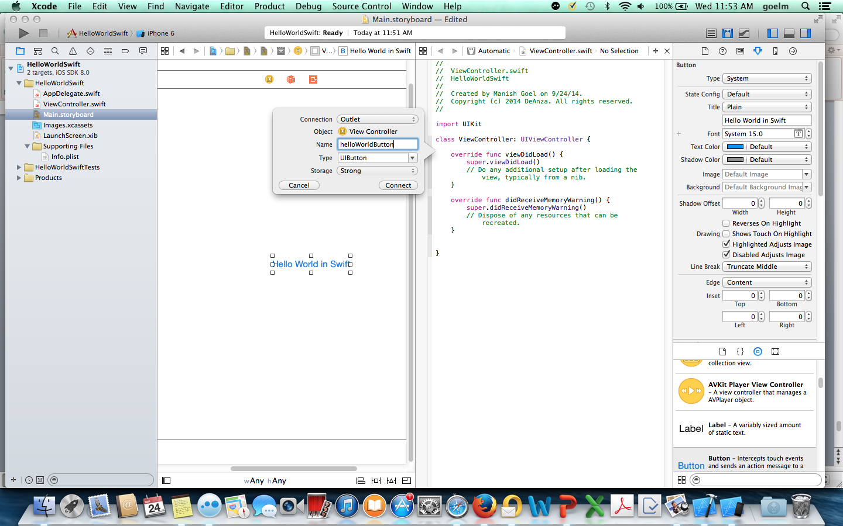
ViewControllers are now classes. Add the Outlet (interface) as the first declaration in the class

Slide 42
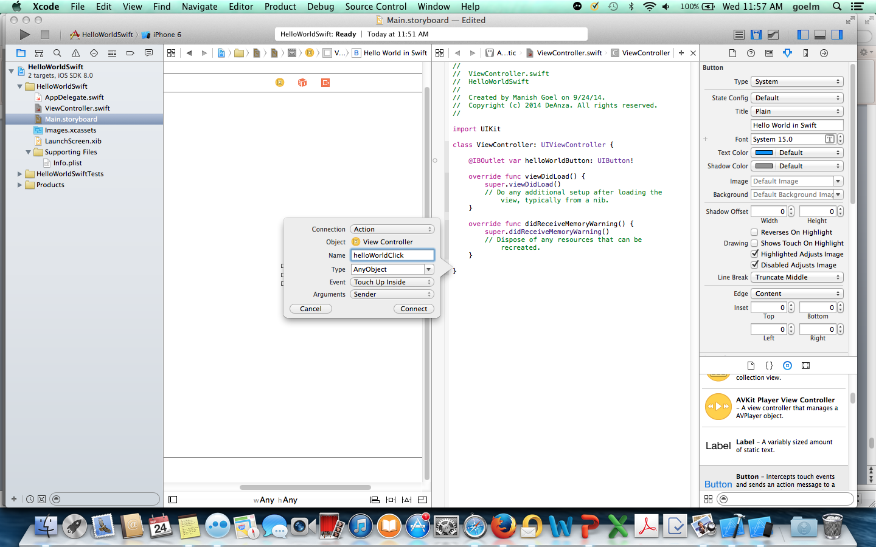
Add the Action to the end of the class

Slide 43
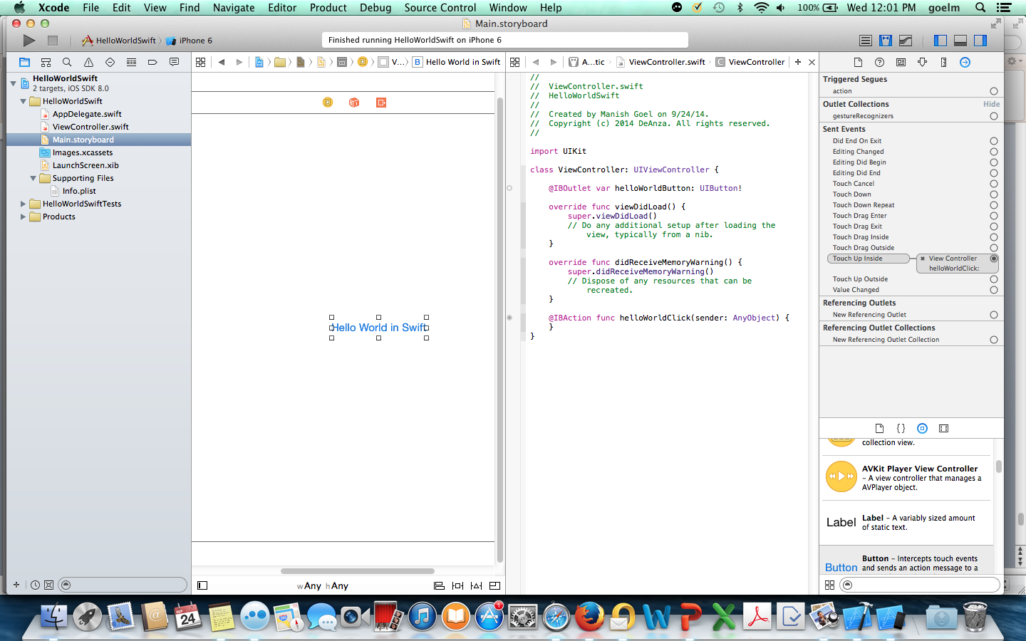
Again, the button and viewcontroller have been connected but no response action has been defined.

Slide 44
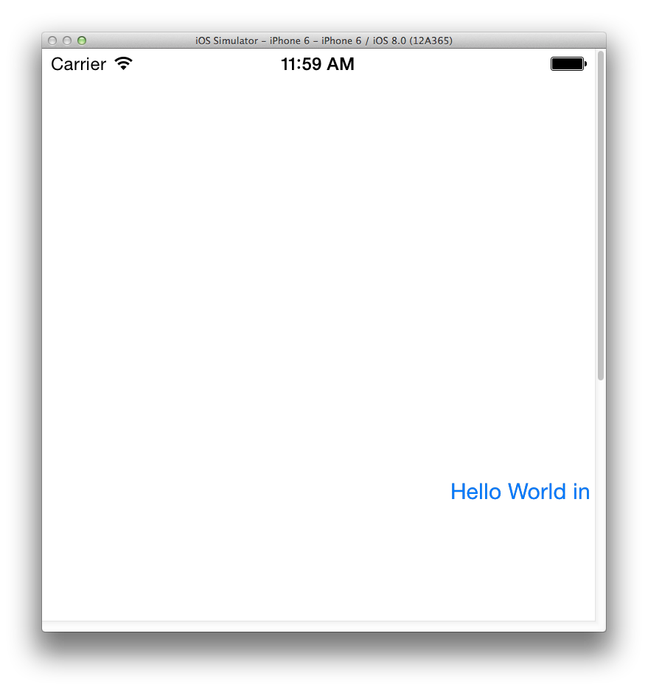

Slide 45
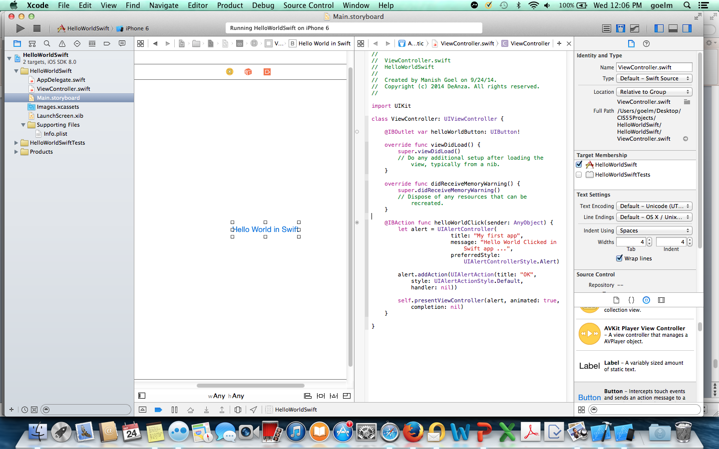

Slide 46
